Slide 1
Voice Controlled Robot
Project submitted by :
1. Jui Deepak Paranjape. (17UEL11066XX)
2. Afrin Husenshaha Momin. (17UEL41059XX)

Slide 2
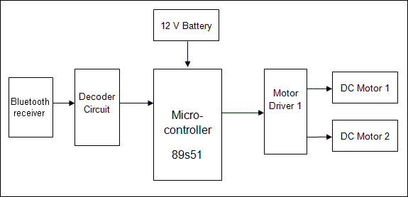
Block Diagram :
HC-05
Bluetooth
ARDUINO
UNO

Slide 3
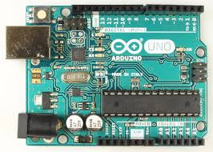
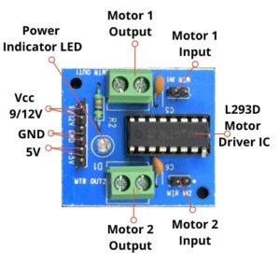
1. Arduino Uno
2.Motor Driver (L293D)

Slide 4
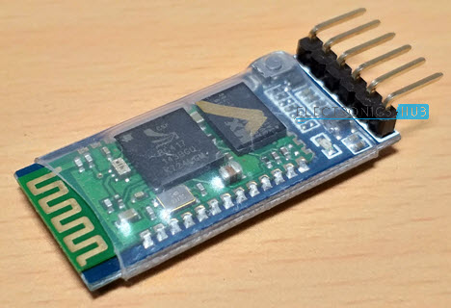
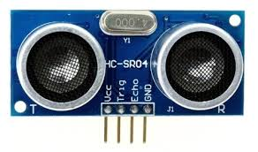
3. HC-05 Bluetooth Module:
4. HC-SR04 Ultrasonic Sensor

Slide 5
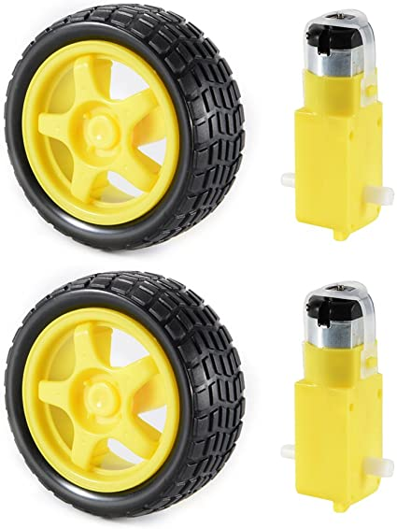
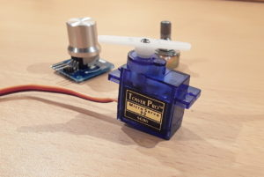
5. Servo motor SG90:
6. DC Motors and Wheels

Slide 6

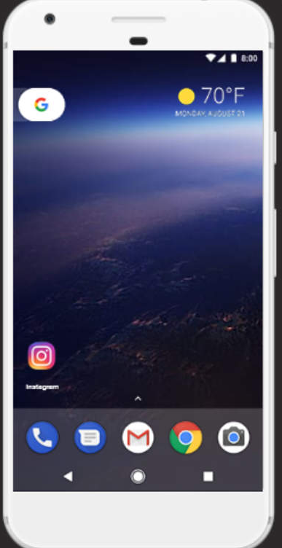
7. 9V Batteries:
8. Android System :

Slide 7
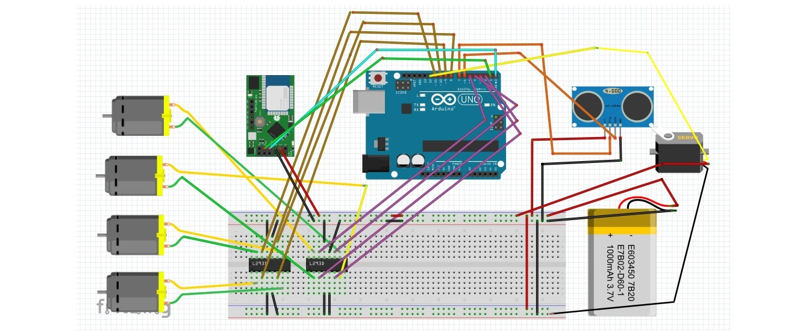
Circuit Diagram :

Slide 8
Advantages: 1. The robot is small in size so can be used for spying. 2. With few additions and modifications, this robot can be used in the borders for detecting and disposing hidden land mines. 3. The robot can be used for reconnaissance or surveillance. Applications: 1.Low range Mobile Surveillance Devices 2.Military Applications (no human intervention) 3.Assistive devices (like wheelchairs) 4.Home automation Future Development: 1. We can interface sensors to this robot so that it can monitor some parameters. 2. We can add wireless camera to this robot.

Slide 9
Thank you !

